Slide 1
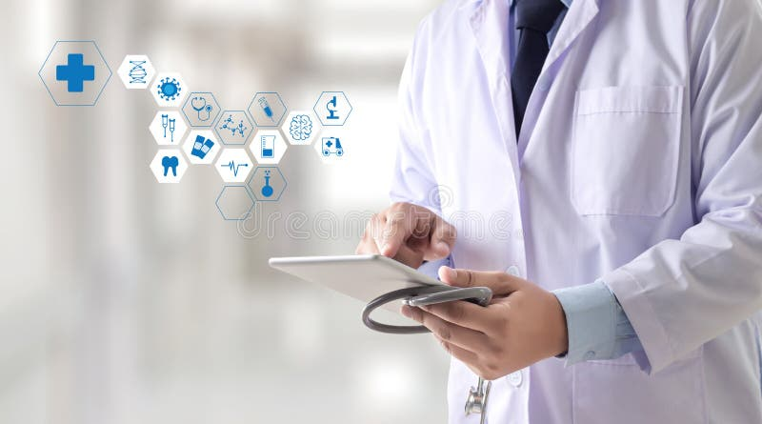
Automatic Generation of Clinical Encounter Summaries from Recordings Using Large Language Models [AI Medical Scribe]
Vinoth Madhavan | VM26426 High Risk Project | AI in Health Care

Slide 2
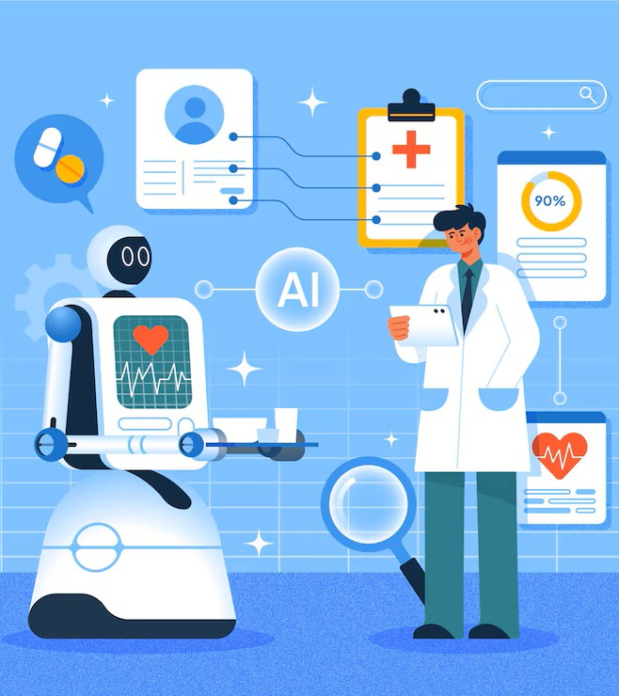
01
INTRODUCTION
02
PROBLEM STATEMENT
03
WORKFLOW
TABLE OF CONTENTS
04
APPROACH
05
TECHNICAL DETAILS
06
RESULTS
07
Future directions

Slide 3
INTRODUCTION
The Need for Advanced Clinical Documentation
Automates structured clinical summaries from patient encounter audio/video.
Utilizes a hybrid pipeline combining advanced ASR (speech-to-text) and LLMs.
Importance
Reduces the burden of manual clinical documentation.
Minimizes errors from incomplete or inconsistent handoff notes.
Improves efficiency and enhances patient safety with standardized summaries.

Slide 4
PROBLEM STAEMENT
Clinical documentation is time-consuming, reducing time available for direct patient care.
Manual notes and dictations are error-prone and vary widely in quality and structure.
Inaccurate or incomplete handoff notes can lead to medical errors and patient safety risks.
Existing speech-to-text tools lack medical domain understanding, struggling with jargon, accents, and conversational complexity.
Large Language Models (LLMs) show promise, but challenges like hallucinations and misattributions remain.
Need for an automated, accurate, and structured clinical summary generation system from audio/video recordings.

Slide 5
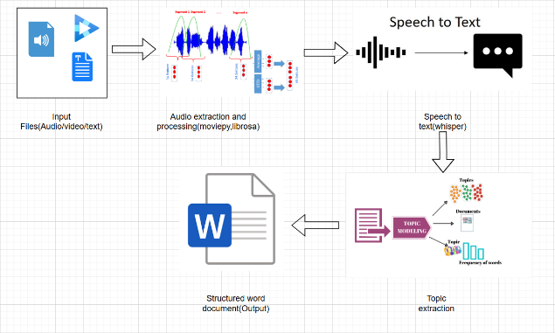
WORKFLOW

Slide 6
APPROACH
Hybrid Pipeline:
Combines speech-to-text (ASR) and large language models (LLMs) for structured clinical summaries.
Input Processing:
Audio Extraction: From video using moviepy.
Preprocessing: Noise reduction and normalization with librosa.
Transcription: Use openai-whisper ASR model for text conversion.
Information Extraction:
LLM Processing: Custom prompts for Google Gemini to extract clinical data (diagnoses, medications, follow-up plans, etc.).
Output Formatting:
Structure and format summary in a standardized Word document using python-docx.
Review & Refinement:
Clinician review for accuracy and completeness. Address errors and hallucinations.

Slide 7
TECHNICAL DETAILS
🎥 Audio Extraction:
moviepy to extract audio from video files.
Librosa for noise reduction and normalization.
📝 Transcription:
openai-whisper for converting audio to text with state-of-the-art speech-to-text.
🤖 LLM Processing:
Custom prompts for Google Gemini LLM to identify and organize key clinical sections.
📄 Formatting:
python-docx to generate a structured, labeled Word document for review and editing.
Repo link: https://github.com/vinothmadhavan/aihc_project/tree/main

Slide 8
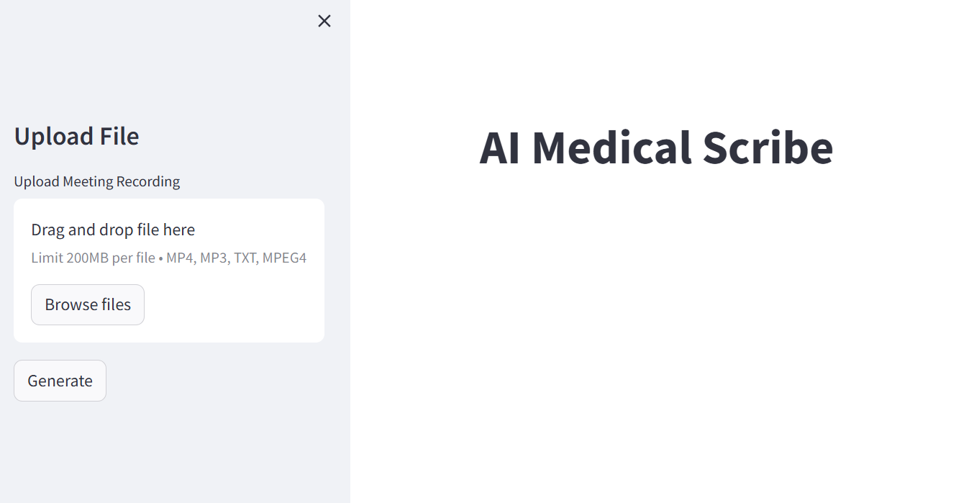
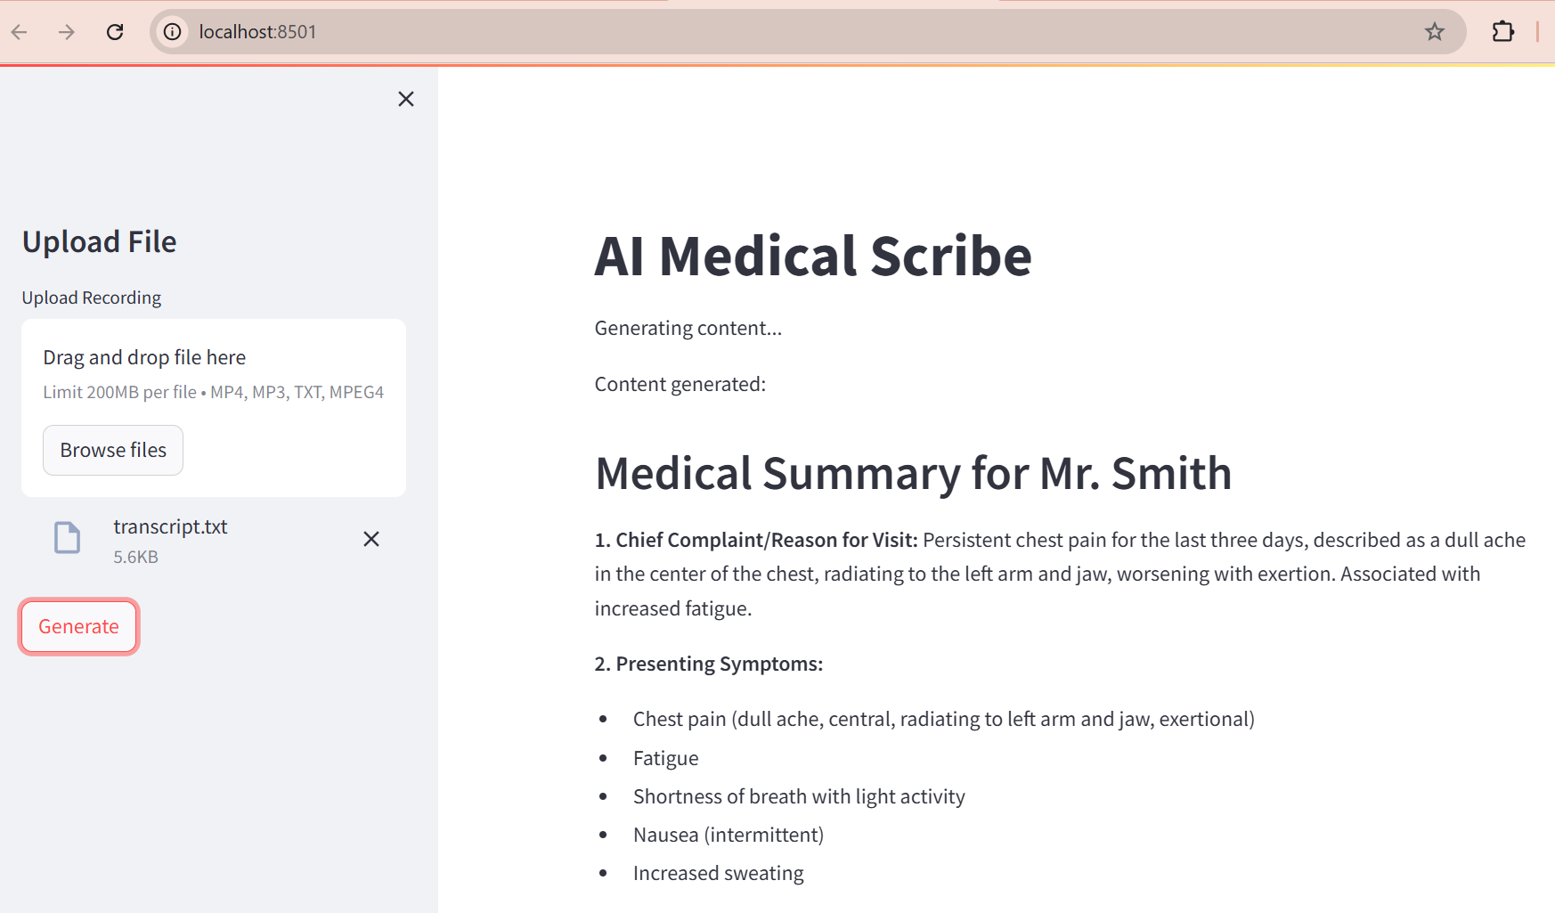
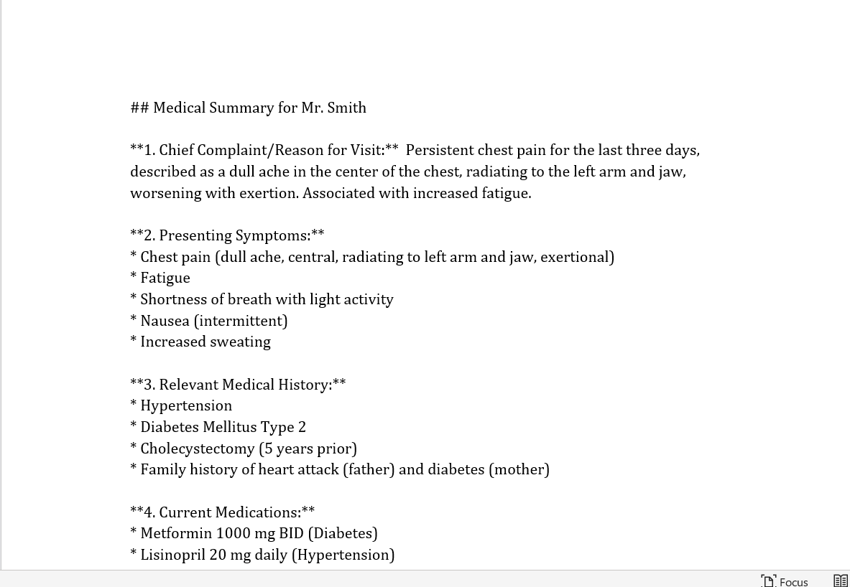
RESULTS
Result in UI
Landing Page
Generated Word

Slide 9
FUTURE DIRECTIONS
This solution can be extended to the entire health care industry in all the places where we need documentation from the conversation or any existing document
Scale this solution
Process PDF, Word, Power Point etc.,
Process recordings in other formats other than mp4 and mp3
Support Multi Accent
Support Multi linguistic
Incrementally update patient history with new files
Add OCR feature to process hard documents patient has etc.,

Slide 10
THANK YOU

